Slide 1
World Indicator- Refugee Data Analysis & Visualization
Soumya Chatterjee

Slide 2
Dataset(s)
Dataset used
World-development-Indicator
https://datacatalog.worldbank.org/dataset/world-development-indicators
What you get:
The World Development Indicators is a compilation of relevant, high-quality, and internationally comparable statistics about global development and the fight against poverty. The database contains 1,600 time series indicators for 217 economies and more than 40 country groups, with data for many indicators going back more than 50 years.

Slide 3
Motivation
As a passionate data science enthusiast I was keen to understand and visualize the WDI data set , to understand the Refugee situation and How this Crisis has unfolded since the last two decades. This exploratory analysis will help us answering the following
Which are the Top countries contributing to Refugees & Who are giving them Asylum
Trend in Refugee count , and when it was at its peak
Analyze Refugee count pattern for selected countries
What percentage of refugee take asylum in USA ?
Hopefully this analysis will guide Other data enthusiast to dig more into other related datasets and find associated causes which created this global phenomenon

Slide 4
Research Question(s)
Which are the Top 10 countries contributing to Refugees & Top 10 countries Who are giving them Asylum
Trend in Refugee count , and when it was at its peak
Analyze Refugee count pattern for selected countries
What percentage of Refugees take asylum in USA ?

Slide 5
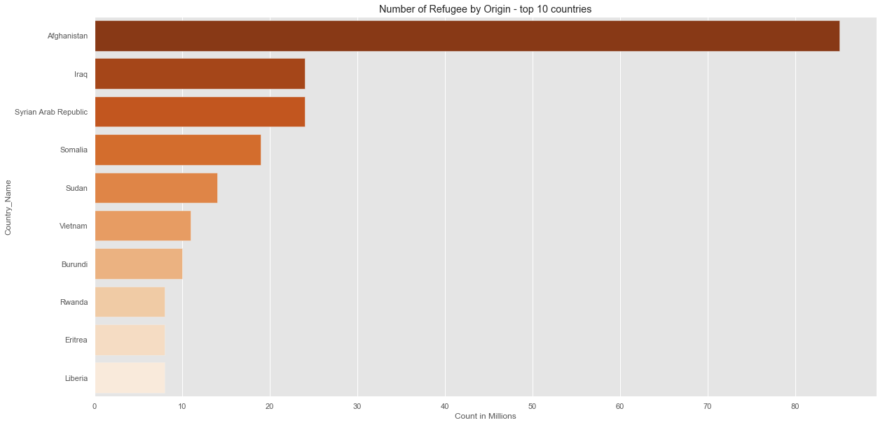
Findings(1) Below visualization shows Top 10 countries for Refugees by Origin between 1990-2018 – Afghanistan being the 1st and Liberia holding the 10th rank

Slide 6
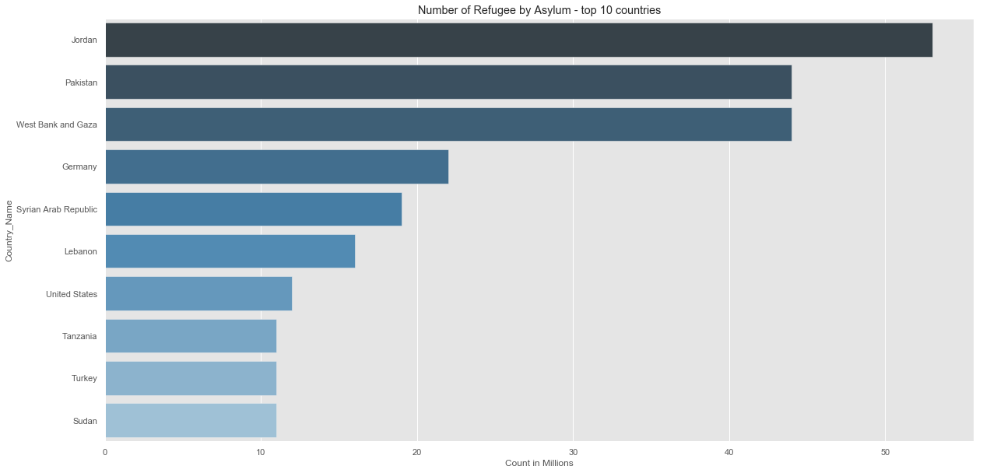
Findings(2) Below visualization shows Top 10 countries for Refugees by Asylum between 1990-2018 – Jordon being the 1st and Sudan holding the 10th rank , USA holding the 7th spot

Slide 7
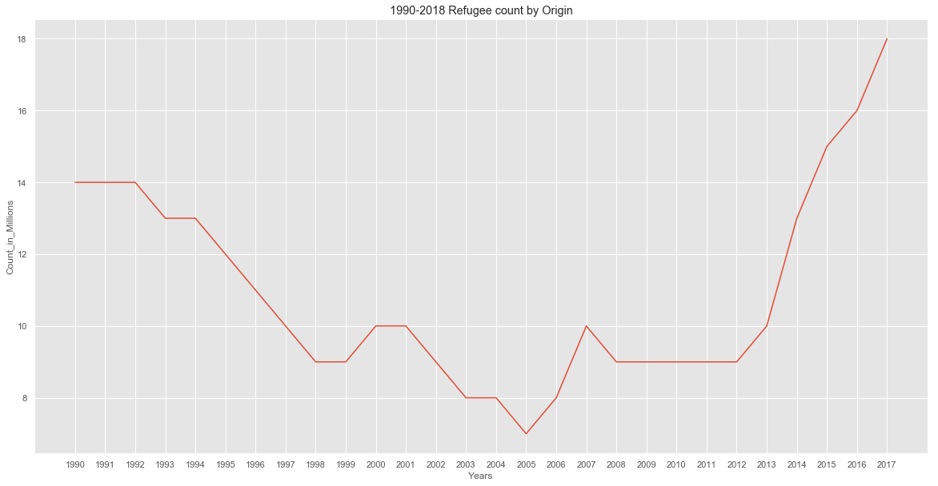
Findings(3) Clearly we can make out from the visualization that we see a downward trend in Refugee count from 1990-2005 , a stale period between 2008-2012 , and an exponential growth/spike since 2012

Slide 8
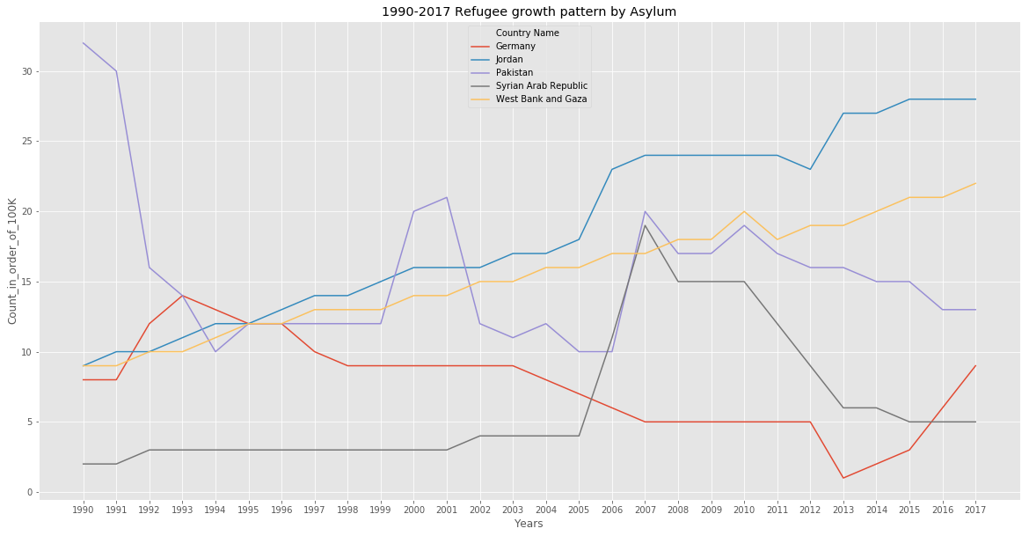
Findings(4)- Refugee trend in Top 5 Asylum countries Clearly we can make out from the visualization that – West Bank & Gaza and Jordon saw a steady growth, where as in other counties numbers spiked in certain times

Slide 9
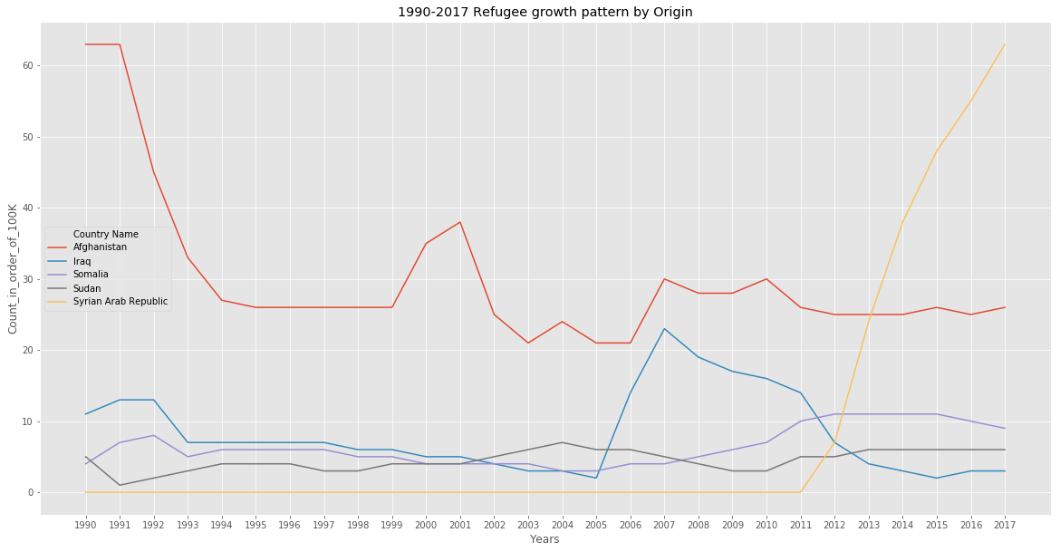
Findings(5)- Refugee trend in Top 5 Origin countries Clearly we can make out from the visualization that – Some event in Syria caused a Exponential spike around 2011-2012

Slide 10
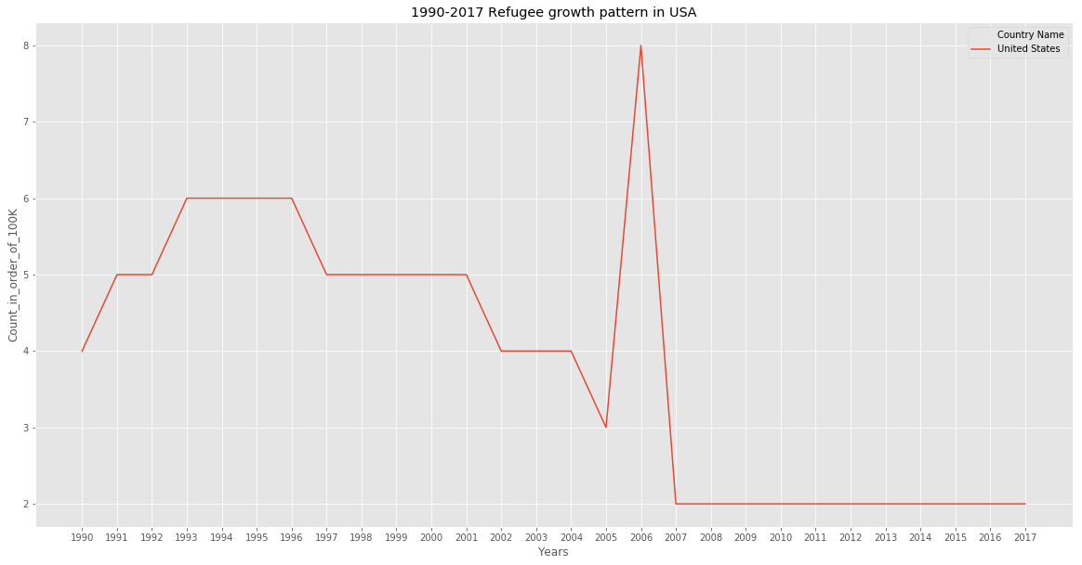
Findings(6)- USA Clearly we can make out from the visualization that – USA saw a growth in Refugee numbers between 2005-2006 , & since 2006 Refugee numbers started declining - reaching and maintaining a alltime low count

Slide 11
Conclusion(s):
Refugee Crisis is Growing specially since 2012
Major cause of this is Syria
However the Refugee asylum in USA has decreased significantly in the last 10 Yrs.

Slide 12
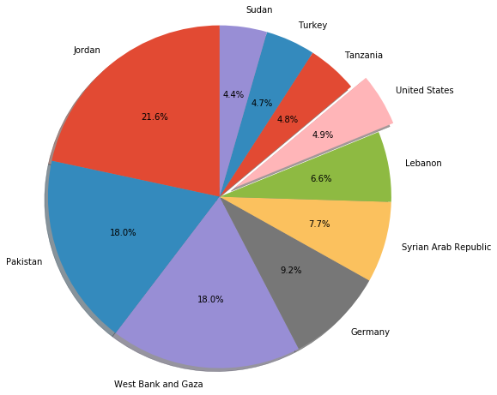
Findings(7)- % distribution between top 10 Asylum countries Only 4.9% of Total Worlds Refugees are taking asylum in USA between 1990-2018

Slide 13
Acknowledgements
Didn’t receive any feedback on the work

Slide 14
References
Bar plot seaborn library
https://seaborn.pydata.org/generated/seaborn.barplot.html
Pie charts in Matplotlib
https://matplotlib.org/1.5.0/examples/pie_and_polar_charts/pie_demo_features.html

